Slide 1


NOISE POLLUTION MONITORING USING IOT SENSORS

Slide 2

TABLE OF CONTENTS
INTRODUCTION
METHODOLOGY
SCHEMATIC DIAGRAM
GAS SENSOR
SOUND SENSOR
ATMEGA MICROCONTROLLER
WIFI MODULE
FLOW CHART
CONCLUSION

Slide 3
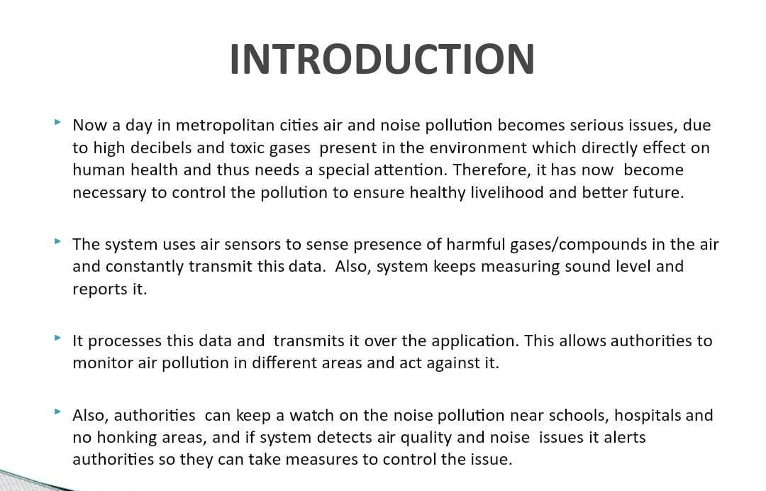

Slide 4
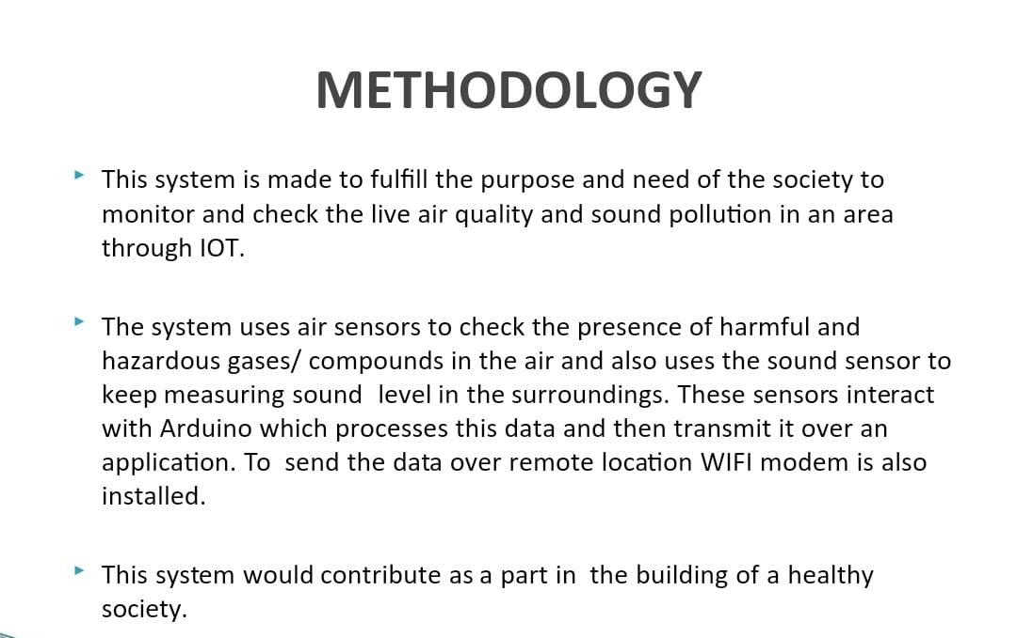


Slide 5
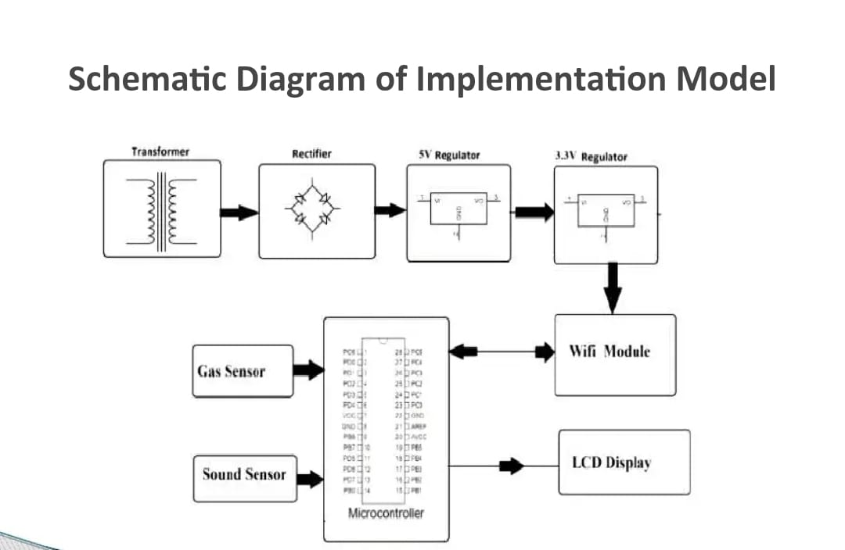

Slide 6
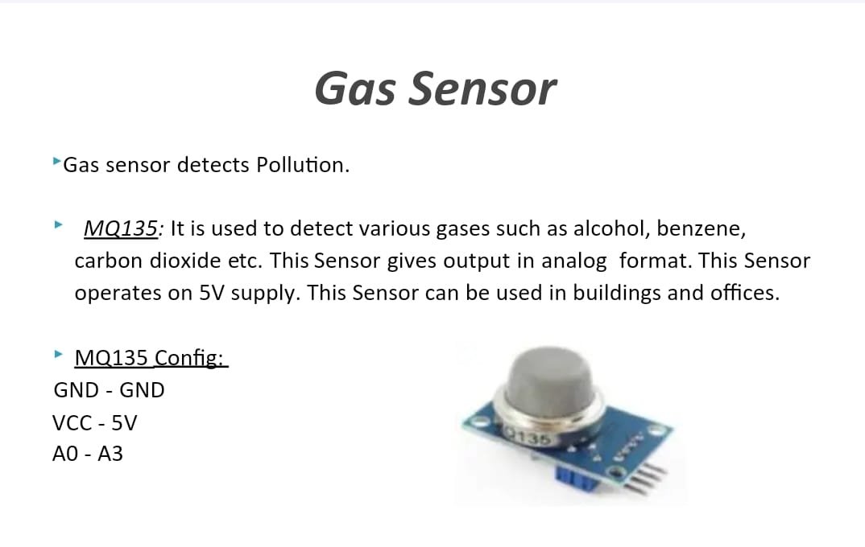

Slide 7
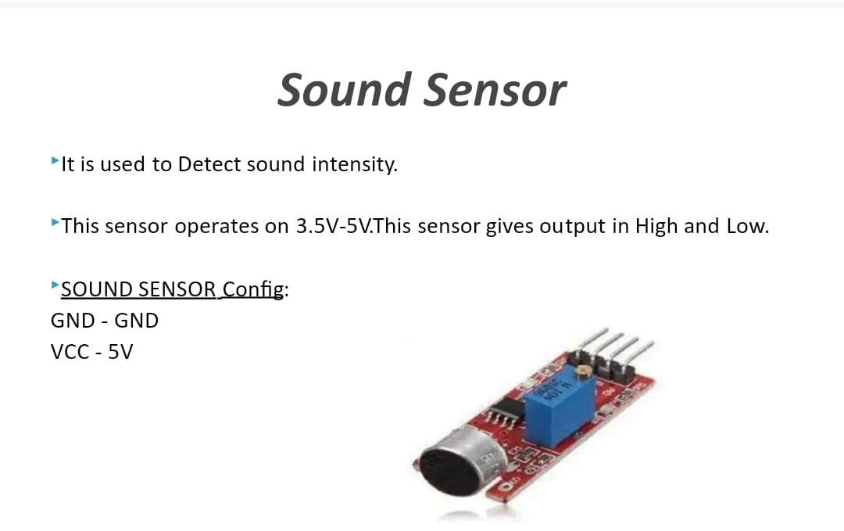

Slide 8
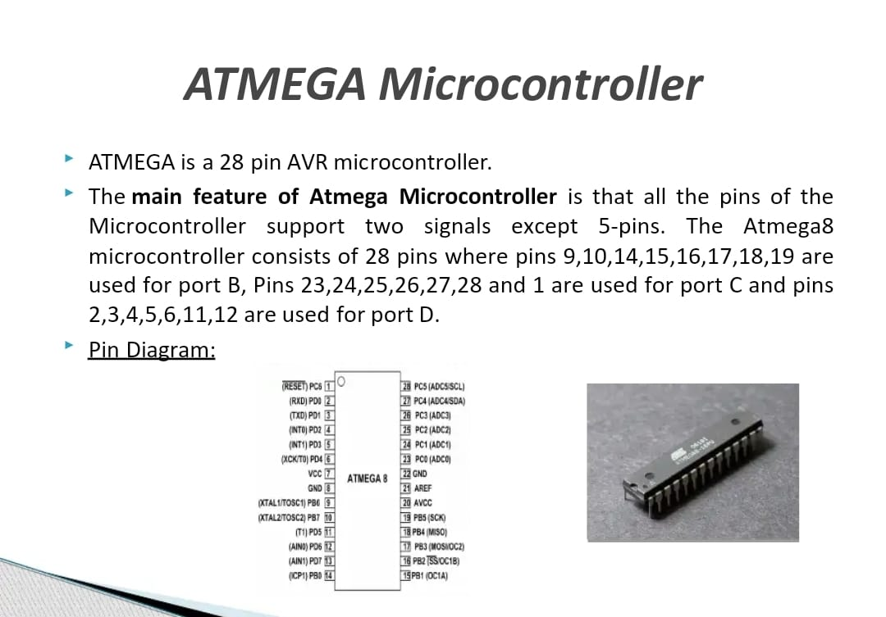

Slide 9
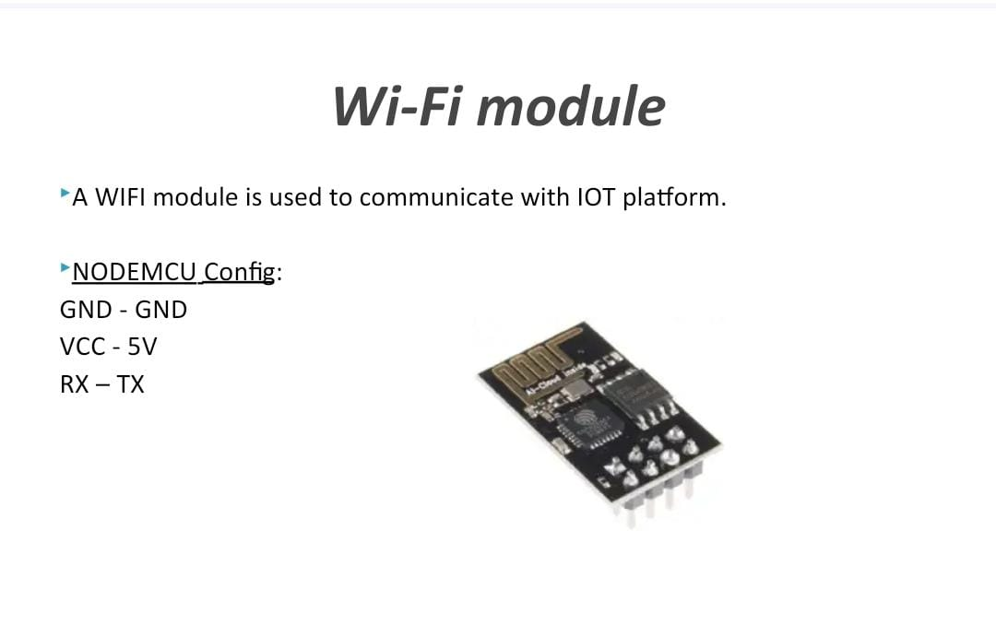

Slide 10
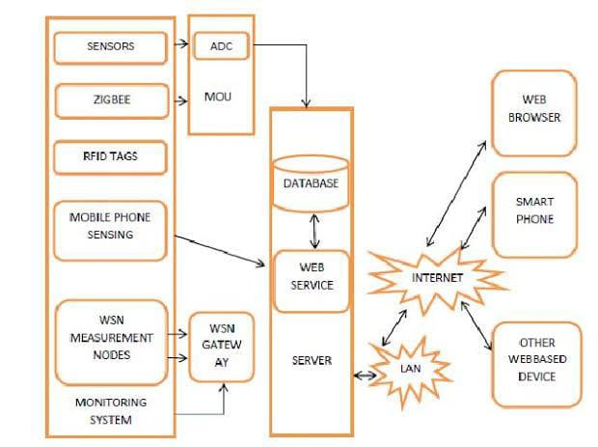
FLOW CHART

Slide 11
CONCLUSION
The design of the sound quality monitoring network basically involves determining the number of station and their locations,with a view of objectives costs and available resources.To assist an industrialist,an expert system should be developed to fix the exact number and distribution of monitoring locations of a sensors.

Slide 12


